Slide 1
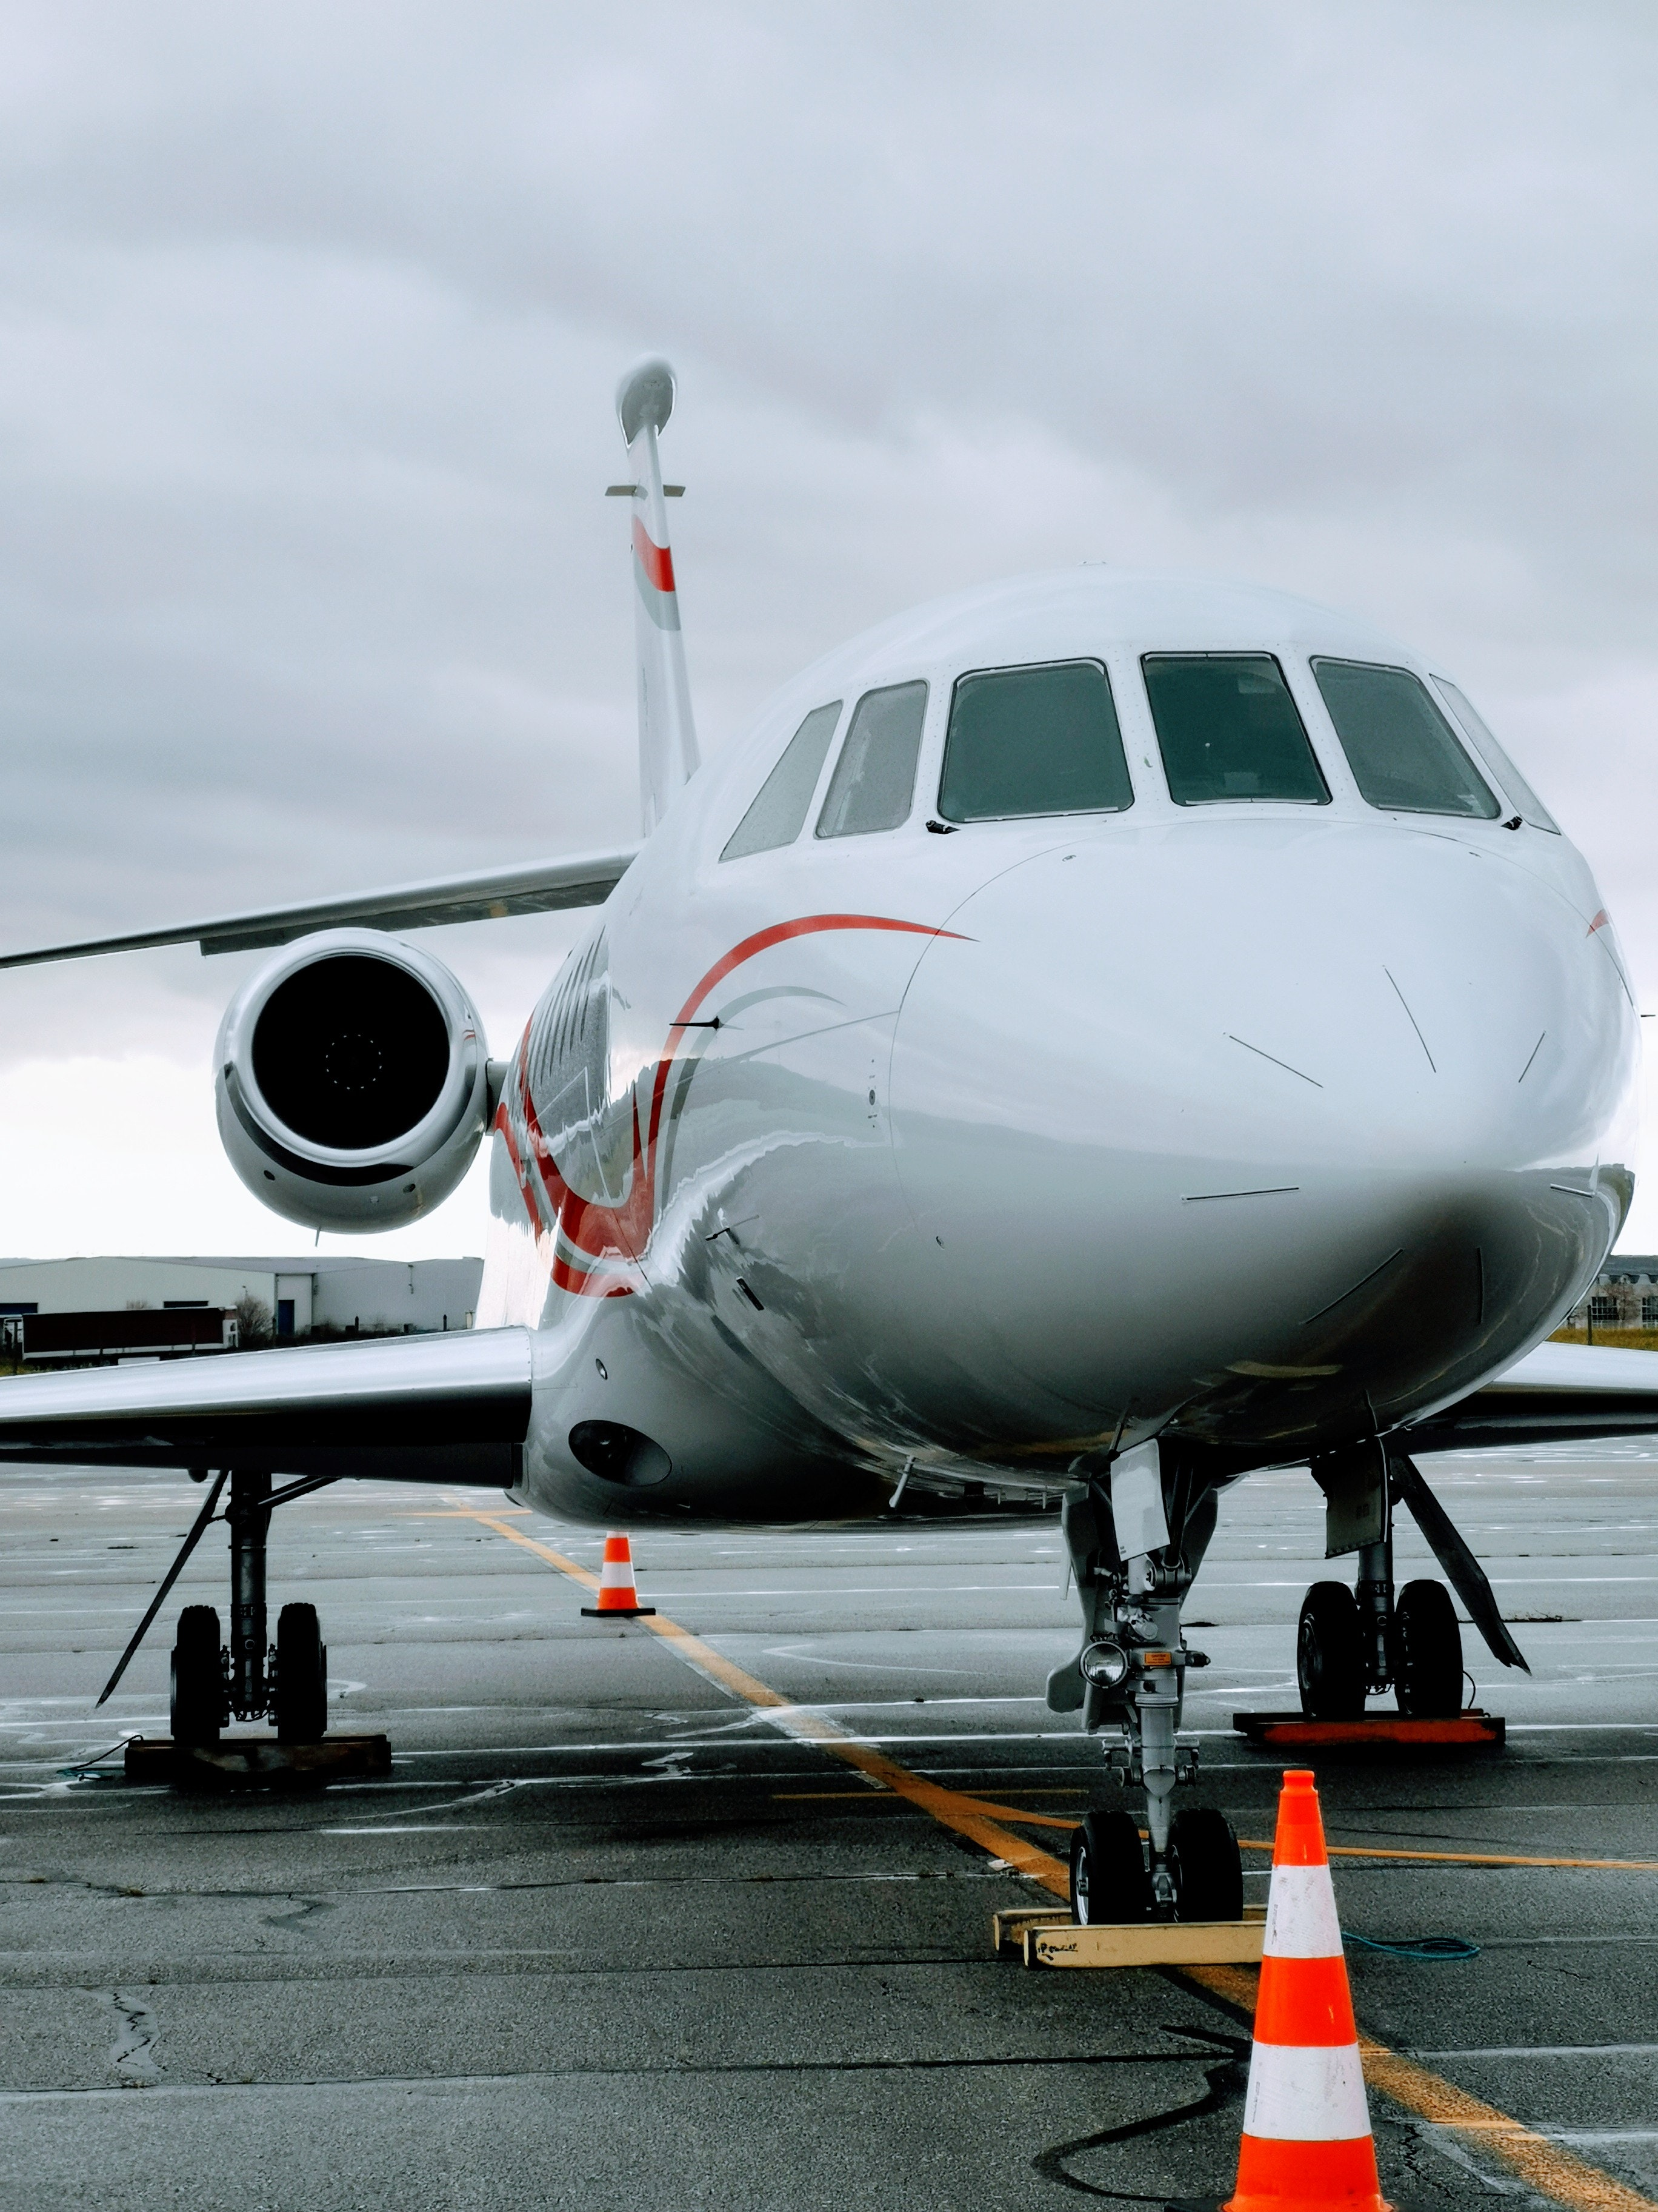
Maximize “Turbofan Engine” Useful Life
Williams Udofia

Slide 2

Business Problem
When should we shutdown for maintenance?
Given Operating Conditions and historical data
Predict the engine’s remaining useful life (RUL)
Schedule engine maintenance to prevent unplanned failure
Runtime
Downtime
Predict engine failure too late, major safety issues
Retire engine too early, fail to maximize engine life, leaves $ on the table
Notes:
The data for this project is sourced from Nasa's C-MAPSS tool. its a tool for simulating realistic large commercial turbofan engine.it can simulate operations ranging from sea level to 40k feet, Mach numbers from 0 to 0.9 and various temperatures.
Turbofan engines, like many systems, experience some form of degradation over their lifetime
This methodology of using sensor data in combination with intelligent methods for prognostics and health management is known as condition-based maintenance (CBM)
For safety reasons, effective CBM solutions are achieved when the RUL predictions are early or exact, as opposed to late (post fault/failure)
Replacement of commercial engine costs $18M - $30M
Maximize engine run time without failure to generate record revenues for our organization
The task was to estimate remaining life of an unspecified system using historical data only irrespective of the underlying physical process
The traditional approach is cost and inefficient
Engineering specialists to calculate the desired outcome
Tedious and lengthy to process large datasets
Subjective performance based on the personnel doing the analysis
Costly and Inefficient
Physical data collection until failure is dangerous

Slide 3
Primary goals
Safety
Reliability / Availability
Cost reduction
Notes:
By leveraging rich data sources and machine learning techniques, predictive maintenance has huge potential to:
save lives of service members
increase mission readiness and
drastically reduce costs,

Slide 4
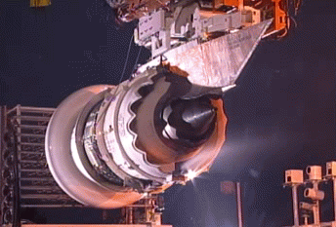
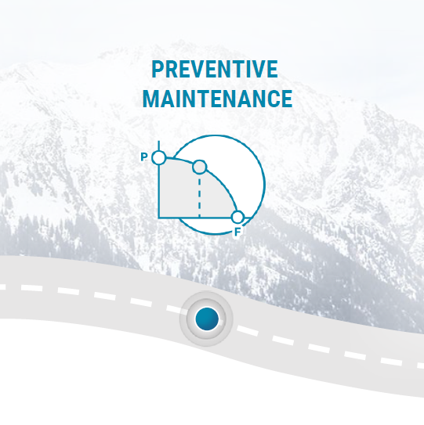
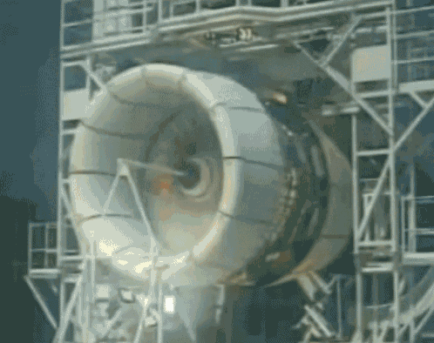
Solution
Predictive / Preventive Maintenance aka Condition-Based Maintenance
Notes:
The data for this project is sourced from Nasa's C-MAPSS tool. its a tool for simulating realistic large commercial turbofan engine.it can simulate operations ranging from sea level to 40k feet, Mach numbers from 0 to 0.9 and various temperatures.
Turbofan engines, like many systems, experience some form of degradation over their lifetime
This methodology of using sensor data in combination with intelligent methods for prognostics and health management is known as condition-based maintenance (CBM)
For safety reasons, effective CBM solutions are achieved when the RUL predictions are early or exact, as opposed to late (post fault/failure)
Replacement of commercial engine costs $18M - $30M
Maximize engine run time without failure to generate record revenues for our organization
The task was to estimate remaining life of an unspecified system using historical data only irrespective of the underlying physical process
The traditional approach is cost and inefficient
Engineering specialists to calculate the desired outcome
Tedious and lengthy to process large datasets
Subjective performance based on the personnel doing the analysis
Costly and Inefficient
Physical data collection until failure is dangerous

Slide 5
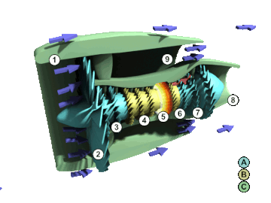
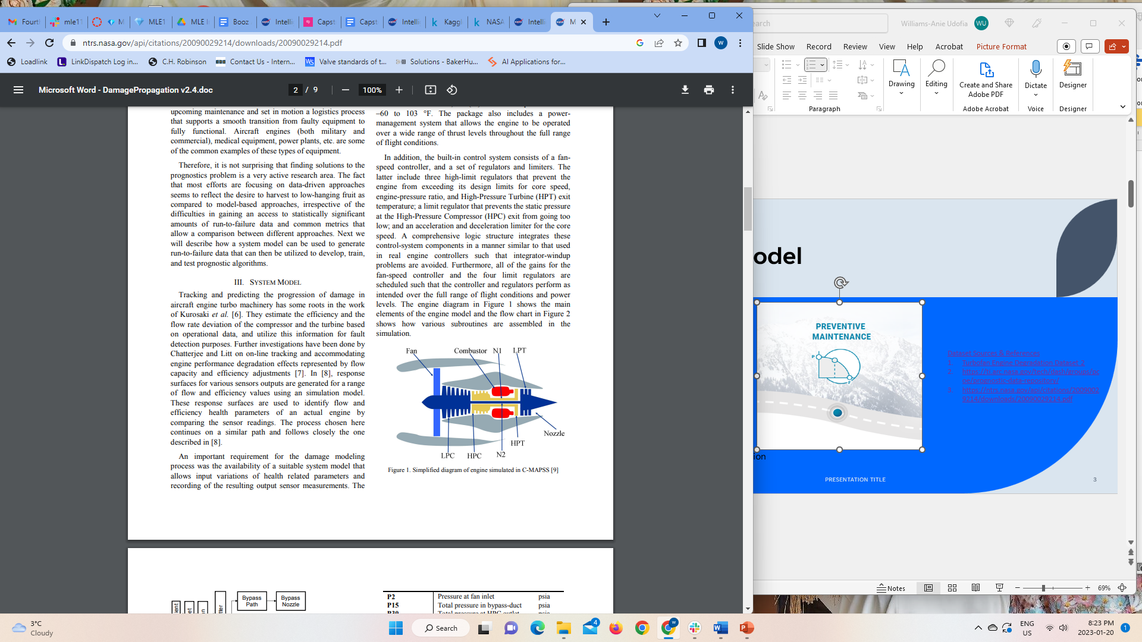
Data + Model
Dataset Sources & References
Turbofan Engine Degradation Dataset 2
https://ti.arc.nasa.gov/tech/dash/groups/pcoe/prognostic-data-repository/
https://ntrs.nasa.gov/api/citations/20090029214/downloads/20090029214.pdf
Source: Wikipedia
Dataset | # Operating Conditions | Fault Modes | Train Size (# engines) | Test Size (# engines)
FD001 | 1 | 1 | 100 | 100
FD002 | 6 | 1 | 260 | 259
FD003 | 1 | 2 | 100 | 100
FD004 | 6 | 2 | 248 | 249
Run to Failure Degradation from NASA Commercial Modular Aero-Propulsion System Simulation (C-MAPSS)
Each dataset is composed of three files:
training set
test set
Remaining Useful Life (RUL) of test set
Compressor & turbine flow rate and efficiencies deviations for fault detection purposes.
Four datasets representing a combination of different operational conditions
Notes:
.
This data set is the Kaggle version of the very well-known public data set for asset degradation modeling from NASA. It includes Run-to-Failure simulated data from turbo fan jet engines.
Engine degradation simulation was carried out using C-MAPSS. Four different were sets simulated under different combinations of operational conditions and fault modes. Records several sensor channels to characterize fault evolution.
The data set was provided by the Prognostics CoE at NASA Ames.
Simulated sensor data generated using Commercial Modular Aero-Propulsion System Simulation (C-MAPSS) from NASA

Slide 6
The Roadmap
Data Preparation
Download data
Preprocess multivariate time series
Split Train / Test
Feature Engineering
Select Best Predictor Features
Train Model, Evaluate, Test & Validate
PyTorch
Build web-app
Deploy model
LSTM
Deploy model in docker container & AWS Cloud platform
1
2
3
4
Notes:
Atmospheric Features: These features represent the ambient air conditions in front of the engine. Assuming ideal dry air properties, we can calculate the air density and speed of sound directly from the pressure and temperature, and flow velocity entering the engine using the provided mach number. Using these we can further calculate the mass flow rate of air entering the engine.
Performance Features: The efficiency of the compressor is directly related to the pressure ratio between the outlet and inlet.
But we don’t have the pressure between the LPC and HPC. Assuming an ideal compressor, the efficiency can be calculated using the temperatures at the outlet and inlets. This gives a proxy to the efficiency of the HPC, which is the other variable used to model the engine wear.

Slide 7
Risk-Based Approach
Aircraft lands after a flight
Health data feed to model
Model runs query
Risk Assessment
Assess the risk of the engine after each flight
Health Notification
Provide equipment health alert to aircraft maintenance teams
RUL Prediction
Predict remaining useful life for engines
Provide guidance on fitness-for-service for medium POF engines
Schedule maintenance for applicable medium and high POF engines
What is the remaining life?
Return aircraft to service
Low POF
Medium POF
High POF
Perform fitness-for-service
Yes
Is aircraft fit for service?
No
Send aircraft for maintenance

Slide 8
Timeline
Project Close-out
Week 6
Data Collection, Preparation and Pre-processing
Week 6-8
Model Selection, Training and Evaluation
Week 8-10
Model App Building
Week 11-13
Deploy app on AWS
Week 14-16

Slide 9
Summary
Develop repeatable & reproducible ML solution to a real-world high-impact problem
Benchmark state-of-the-art Turbofan Engine life prediction
Develop risk-based maintenance strategy for critical assets
Maximize availability of production-critical assets

Slide 10
Business opportunities are like buses. There's always another one coming.
“
”
Richard Branson

Slide 11
Thank you

Slide 12
Backup

Slide 13
How we get there
Data Preparation & Pre-processing
Feature Engineering
Model Train, Evaluate, Test & Validation
Atmospheric Features
Performance Features
Eliminate Features
PyTorch
LSTM
Download Open-source data
Preprocess Multivariate time series
Split Train / Test Data
Deploy model
Build web-app
Deploy model in docker container & AWS

Slide 14
Backup
 | Model Metrics | Business Metrics | ROI | E-commerce
Q1 | 4.5 | 2.3 | 1.7 | 5.0
Q2 | 3.2 | 5.1 | 4.4 | 3.0
Q3 | 2.1 | 1.7 | 2.5 | 2.8
Q4 | 4.5 | 2.2 | 1.7 | 7.0

Slide 15
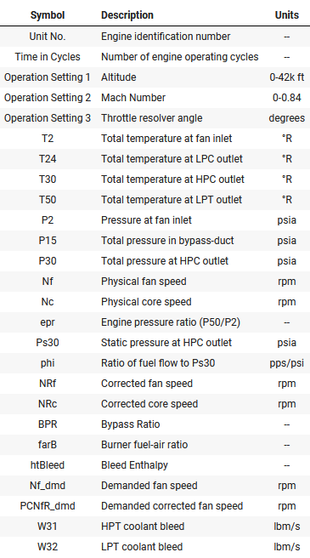
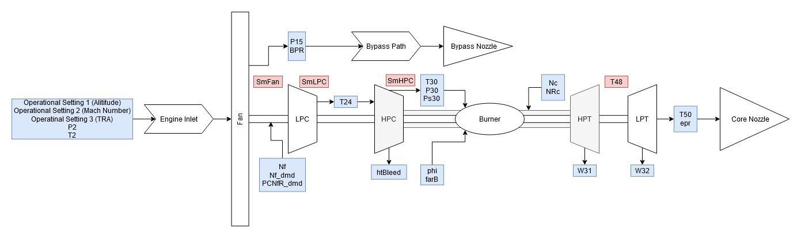
Data Source
Simulated sensor data generated using Commercial Modular Aero-Propulsion System Simulation (C-MAPSS) from NASA
Notes:
Engines 1 and 3 are in operating condition 1 only.
Engines 2 and 4 are a mixture of all operating conditions.
A total of 790 engines was included.
Train data consisted of engines run to failure.
Test data withheld sensor data close to failure.
We used the train data to build and validate our Model.

Slide 16
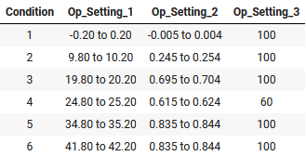
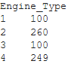
Data Source
Engine data consisted of 4 engine types in 6 different operating conditions.
Provided a test and train dataset of each engine.
Notes:
Engines 1 and 3 are in operating condition 1 only.
Engines 2 and 4 are a mixture of all operating conditions.
A total of 790 engines was included.
Train data consisted of engines run to failure.
Test data withheld sensor data close to failure.
We used the train data to build and validate our QuAM.

Slide 17
Meet our team
Williams Udofia
??
President
Chief Executive Officer

